Slide 1
Seismic Wave Propagation & Forward Simulation Advances in Quantum
ErSE-299: Directed Research
Advisor: Prof. David Keyes
Amnah Samarin
Notes:
ID=d924773e-9a16-4d6d-9803-8cb819e99682
Recipe=text_billboard
Type=TextOnly
Variant=0
FamilyID=AccentBoxWalbaum_Zero

Slide 2
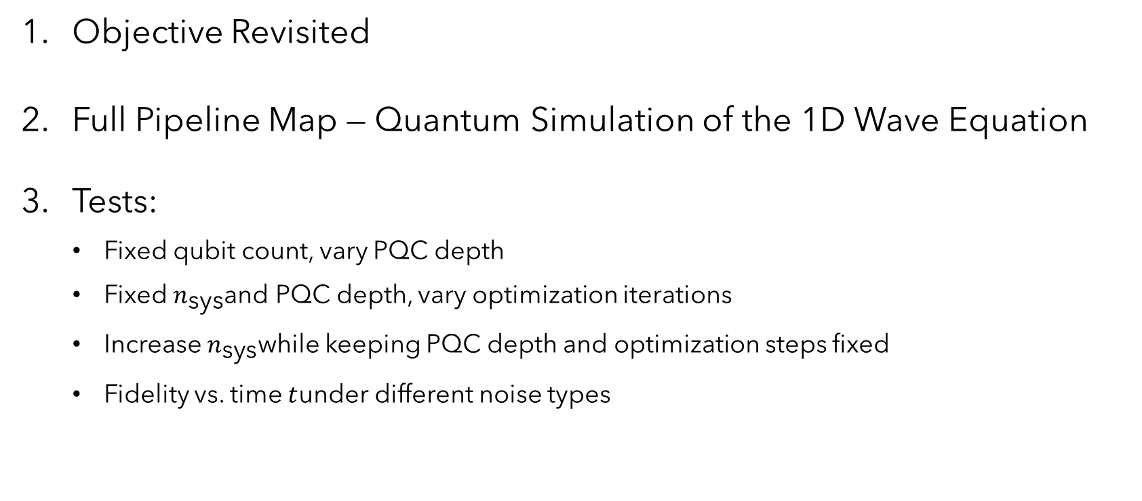
Agenda
Objective Revisited
Full Pipeline Map — Quantum Simulation of the 1D Wave Equation
Tests:
    Fixed qubit count, vary PQC depth
    Fixed $n_{\text{sys}}$and PQC depth, vary optimization iterations
    Increase $n_{\text{sys}}$while keeping PQC depth and optimization steps fixed
    Fidelity vs. time $t$under different noise types

Slide 3
Objective
This project aims to understand and explore how quantum computers—particularly NISQ-era gate-based devices—can simulate the 1D acoustic wave equation using recent theoretical developments.
The work builds on:
Quantum Algorithm for Simulating the Wave Equation (Phys. Rev. A, 2019), which introduces Schrödingerization and the QFT-based spectral formulation of PDEs.
Noisy Intermediate-Scale Quantum Simulation of the 1D Wave Equation (Wright et al., 2024), which demonstrates a hardware-efficient approximation (Eq. 14) suitable for real NISQ hardware—this is the algorithm reproduced and studied in the notebook.
By implementing these methods end-to-end, the project evaluates how accurately and efficiently a quantum device can reproduce wave propagation dynamics in a form that parallels seismic forward modeling, and assesses the feasibility of integrating such quantum techniques into future geophysical workflows.

Slide 4
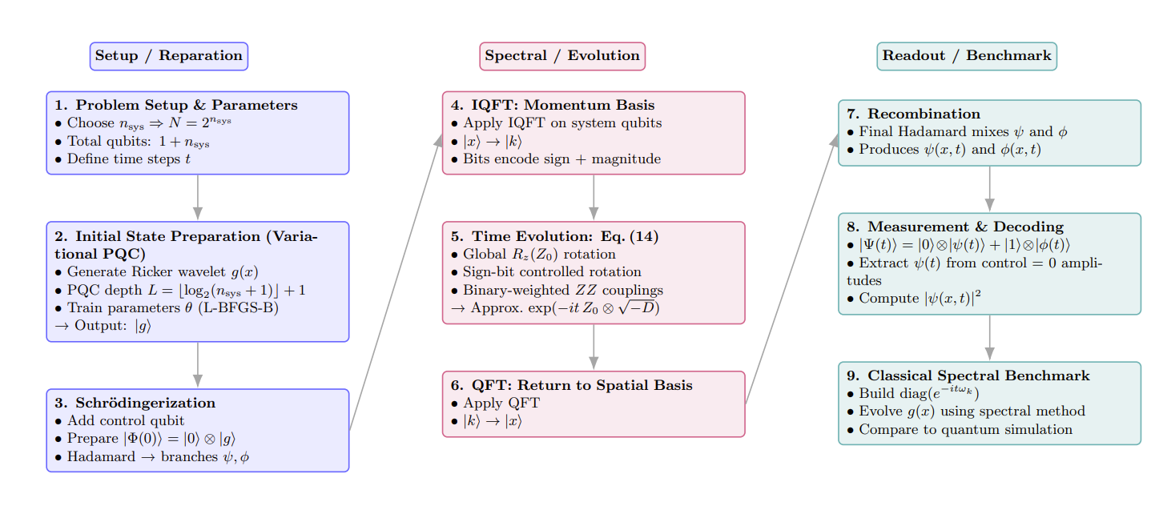
Full Pipeline Map — Quantum Simulation of the 1D Wave Equation

Slide 5
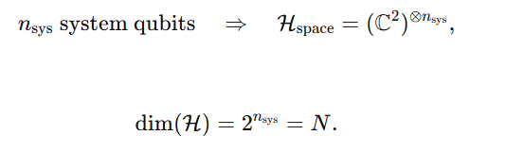
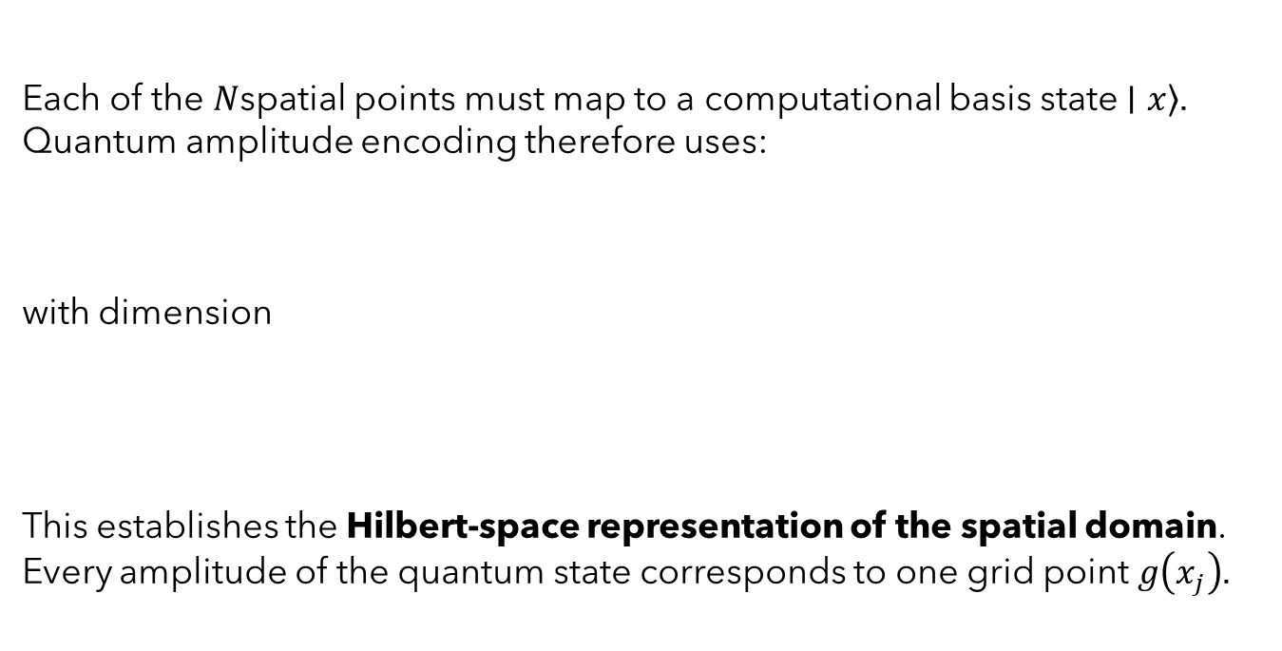
Each of the $N$spatial points must map to a computational basis state $\left.∣x\right\rangle$.
Quantum amplitude encoding therefore uses:
with dimension
This establishes the Hilbert-space representation of the spatial domain.
Every amplitude of the quantum state corresponds to one grid point $g\left(x_{j}\right)$.

Slide 6


The continuous wavelet function need to efficiently encoded into the amplitude distribution over the computational basis. The PQC (Variational Circuit) prepares the initial displacement field:
The Ricker wavelet is a localized oscillatory function often used to represent a pulse:
They discretize this over N grid points and normalize it to unit norm to be a valid quantum state.

Slide 7
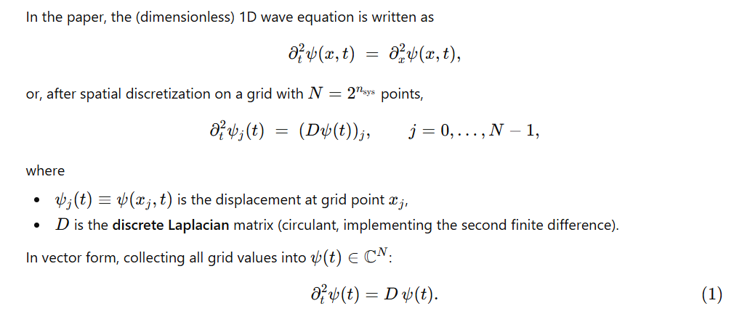
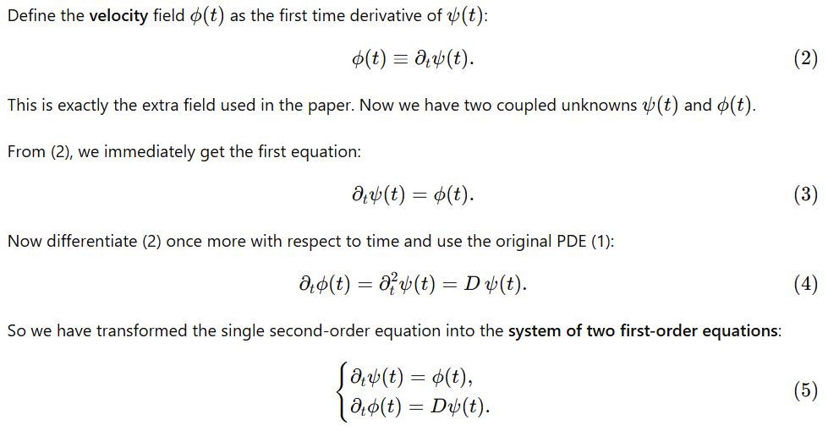
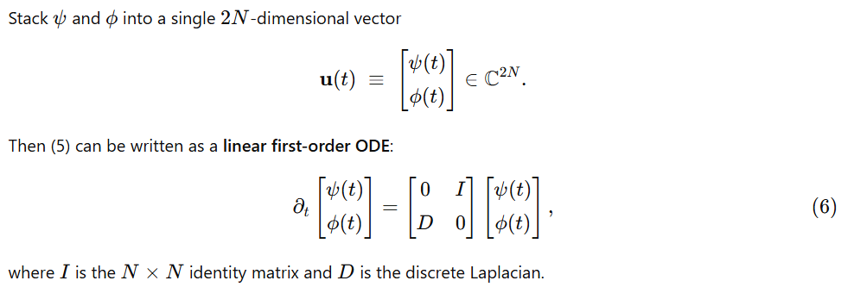

Slide 8
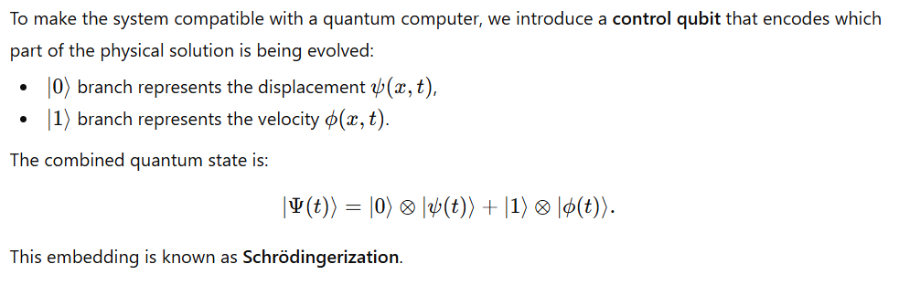
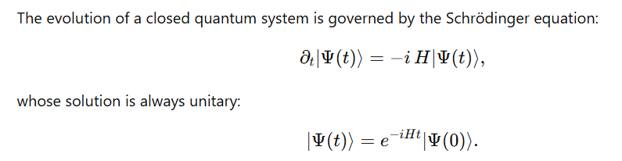
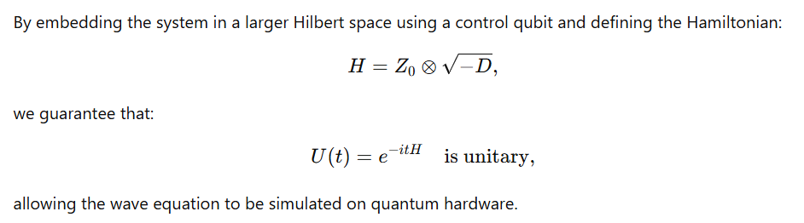
Notes:
Schrödingerization: Embedding the System into a Unitary Quantum Form

Slide 9
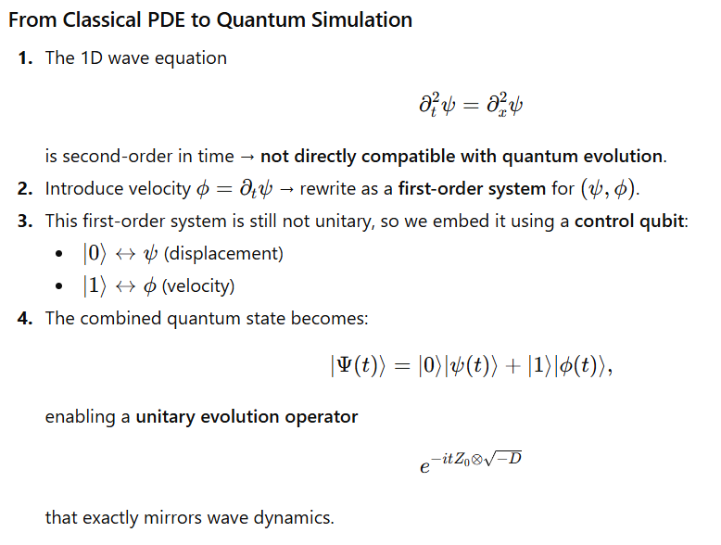
Summery
Notes:
Summery

Slide 10
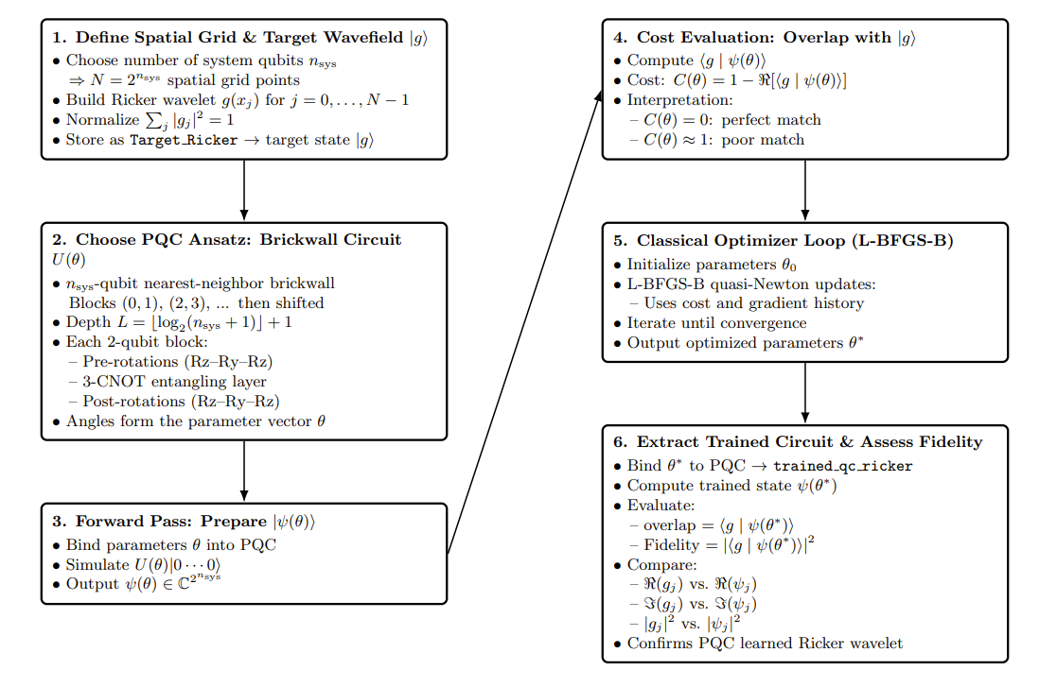
VQA
Notes:
Summery

Slide 11
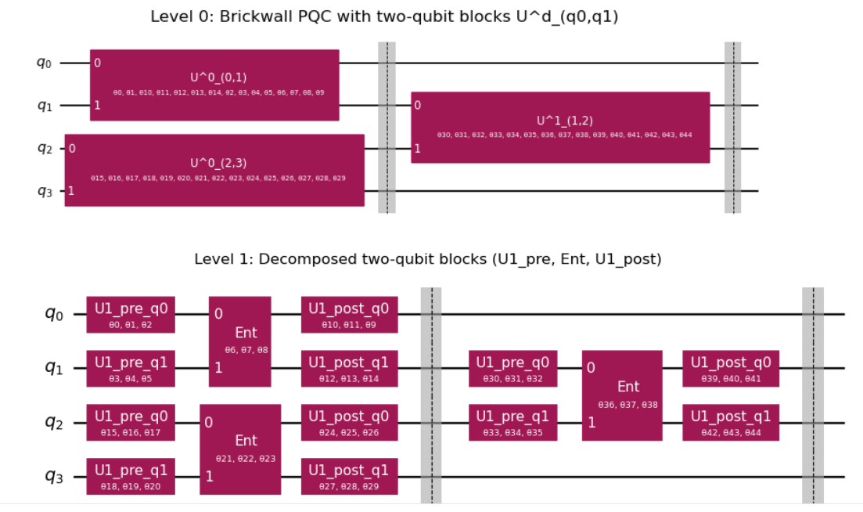

Slide 12
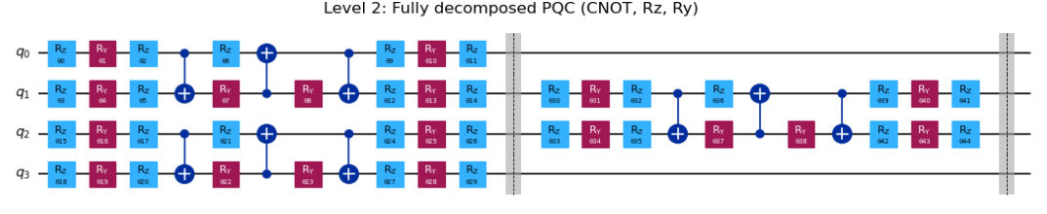

Slide 13
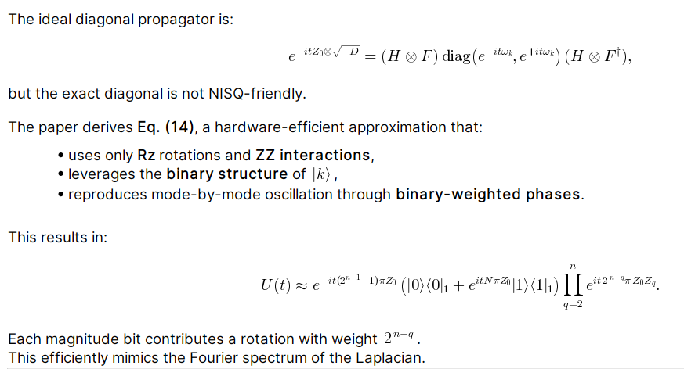

Slide 14
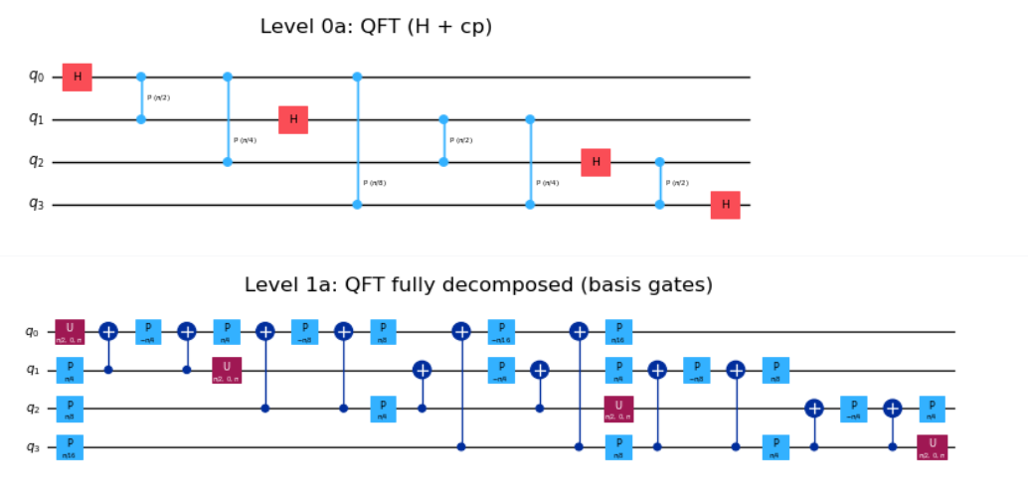

Slide 15
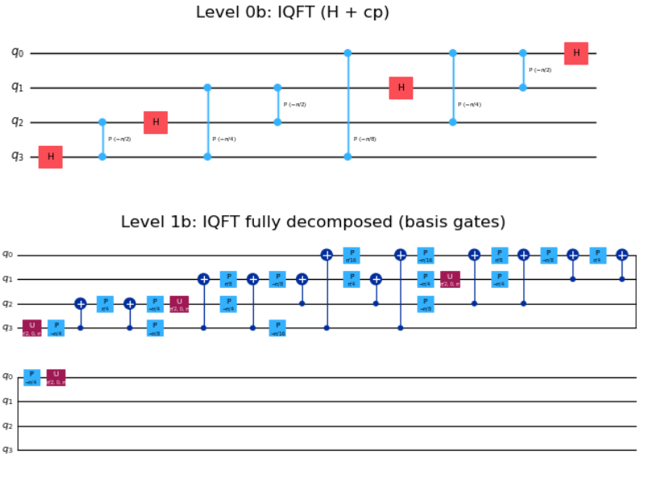

Slide 16
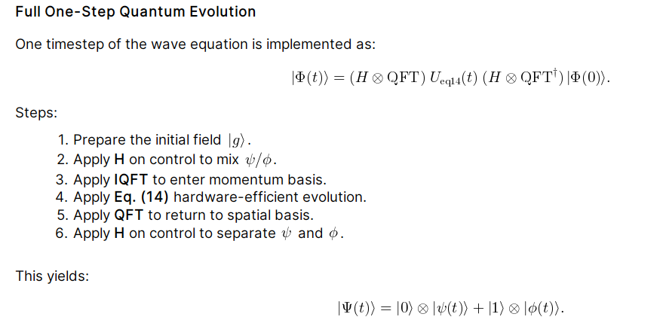

Slide 17
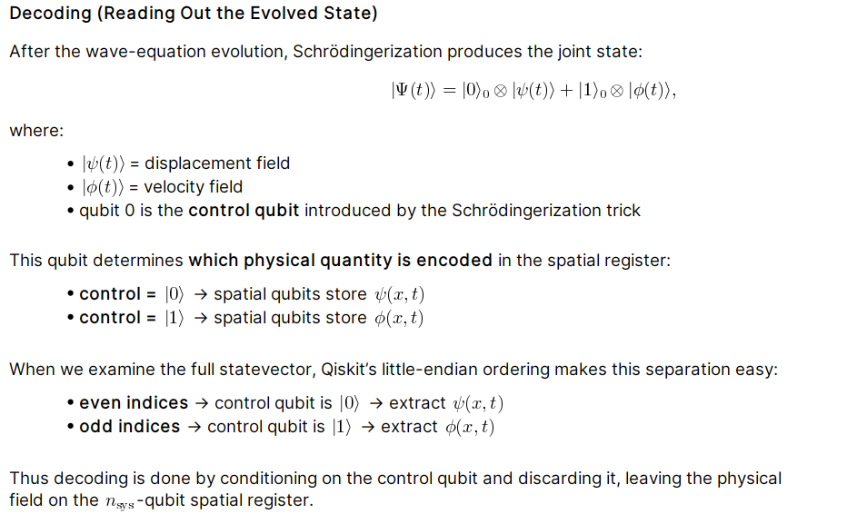

Slide 18
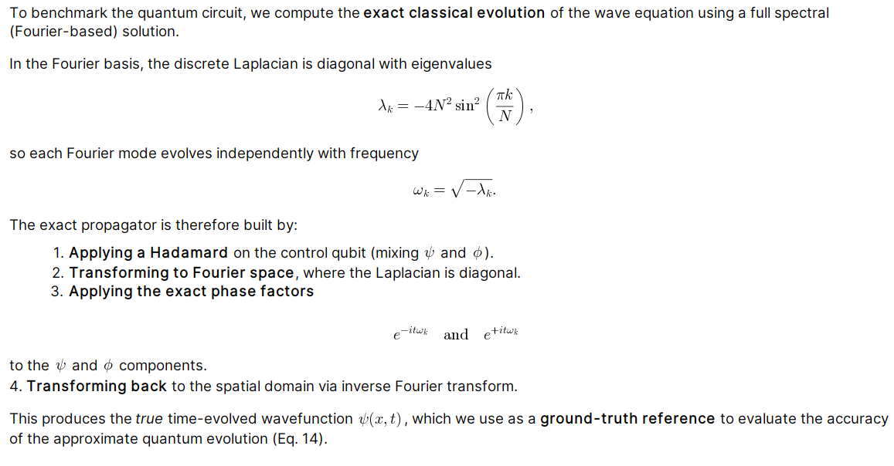

Slide 19
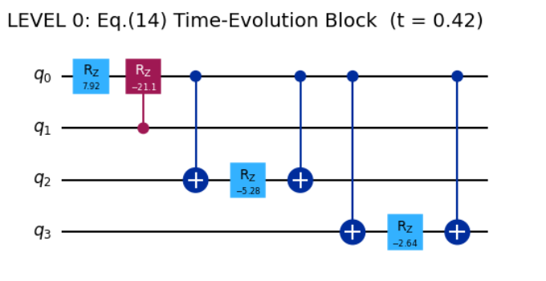

Slide 20
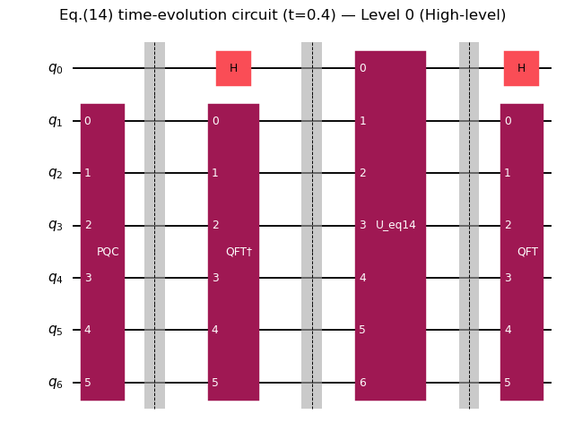
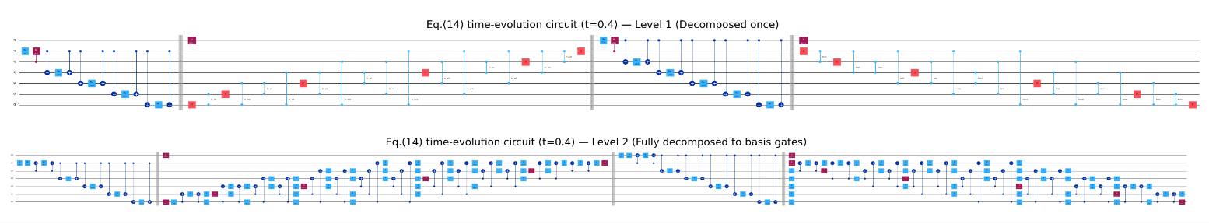
1D Wave Equation Circuit
VQA First!

Slide 21
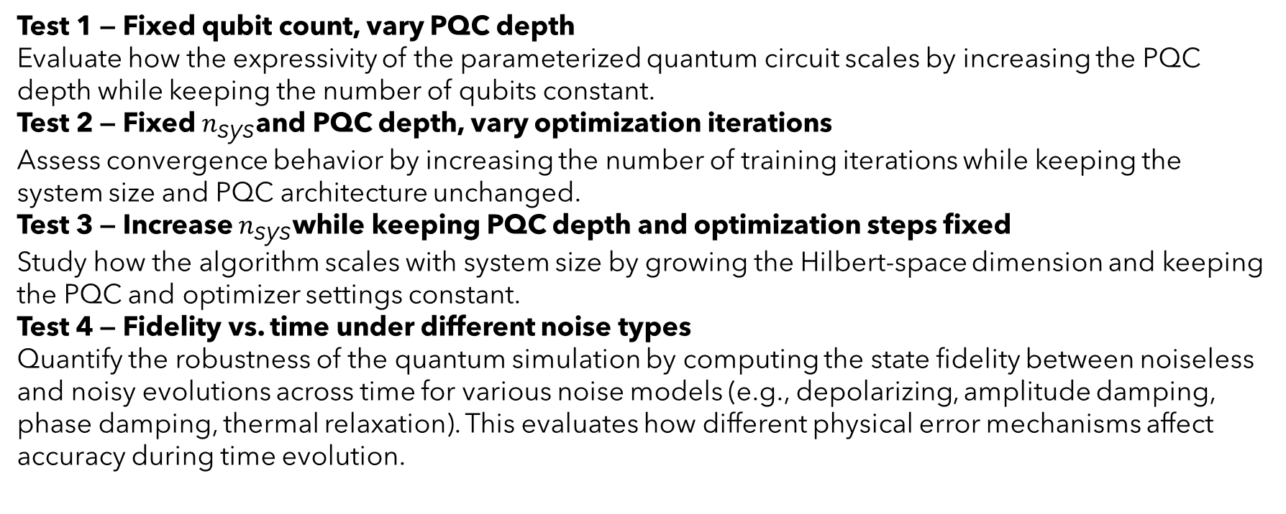
Tests
Test 1 — Fixed qubit count, vary PQC depth
Evaluate how the expressivity of the parameterized quantum circuit scales by increasing the PQC depth while keeping the number of qubits constant.
Test 2 — Fixed $n_{\text{sys}}$and PQC depth, vary optimization iterations
Assess convergence behavior by increasing the number of training iterations while keeping the system size and PQC architecture unchanged.
Test 3 — Increase $n_{\text{sys}}$while keeping PQC depth and optimization steps fixed
Study how the algorithm scales with system size by growing the Hilbert-space dimension and keeping the PQC and optimizer settings constant.
Test 4 — Fidelity vs. time under different noise types
Quantify the robustness of the quantum simulation by computing the state fidelity between noiseless and noisy evolutions across time for various noise models (e.g., depolarizing, amplitude damping, phase damping, thermal relaxation). This evaluates how different physical error mechanisms affect accuracy during time evolution.

Slide 22
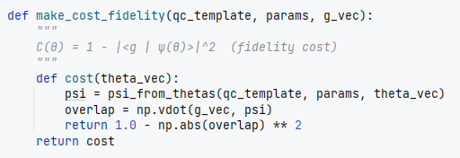
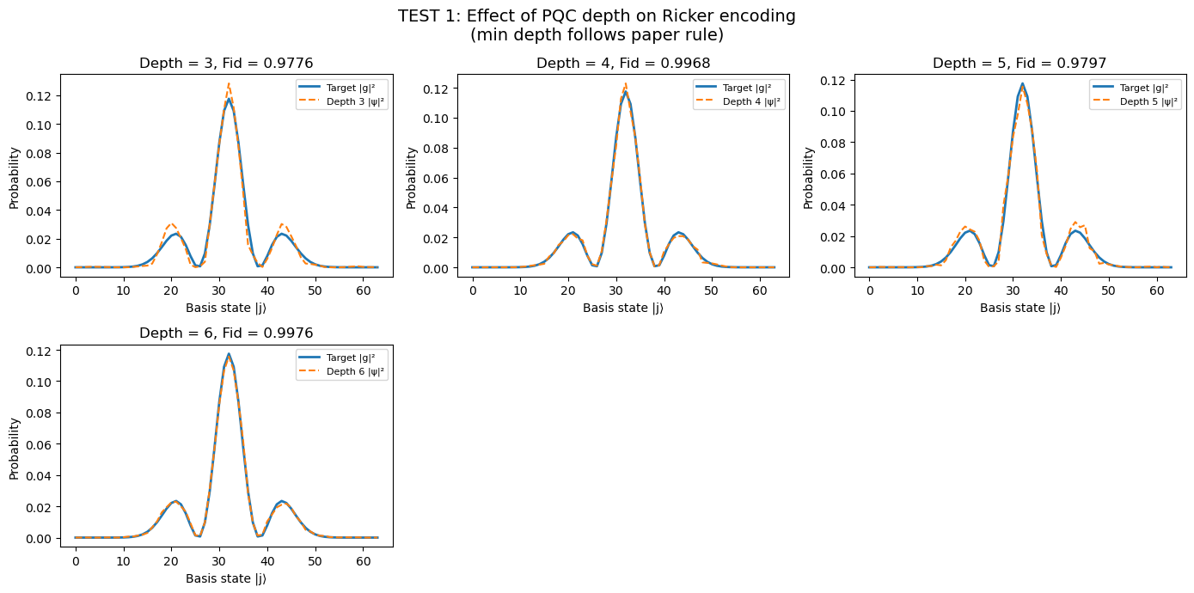
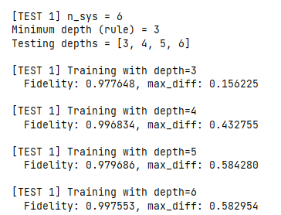
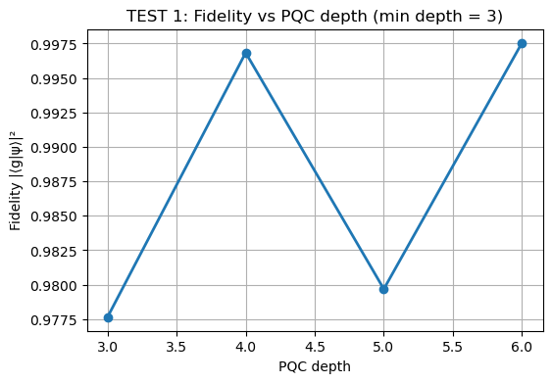
Test1 - Vary PQC depth

Slide 23
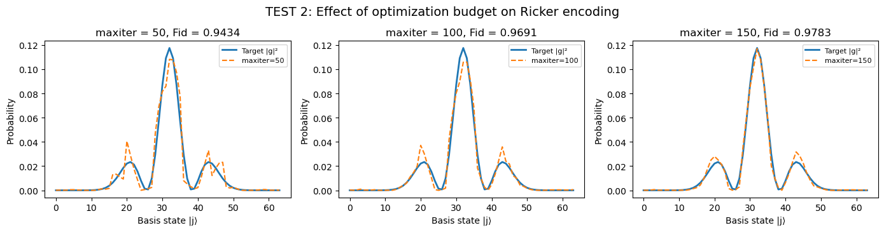
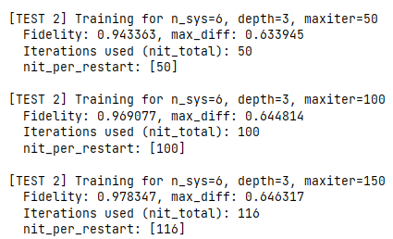
Test2 - Vary optimization iterations

Slide 24
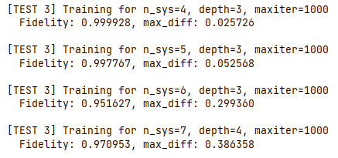
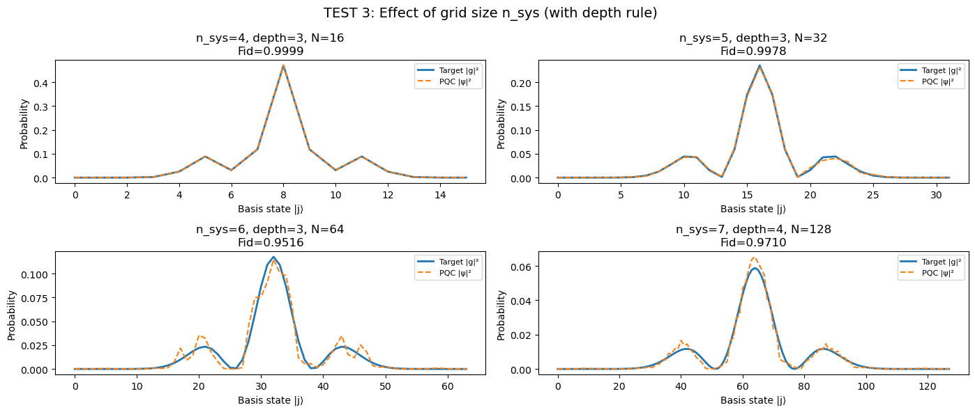
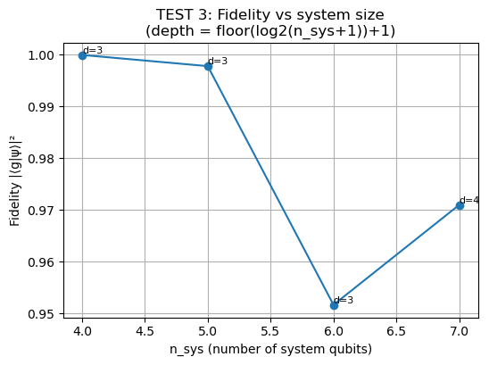

Test3 - Increase $n_{\text{sys}}$

Slide 25
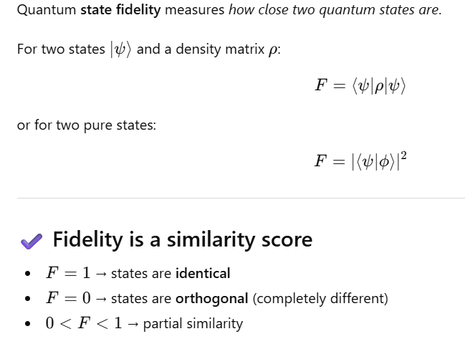
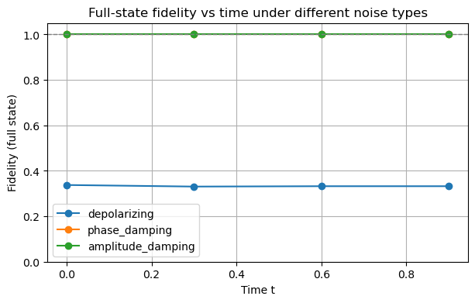
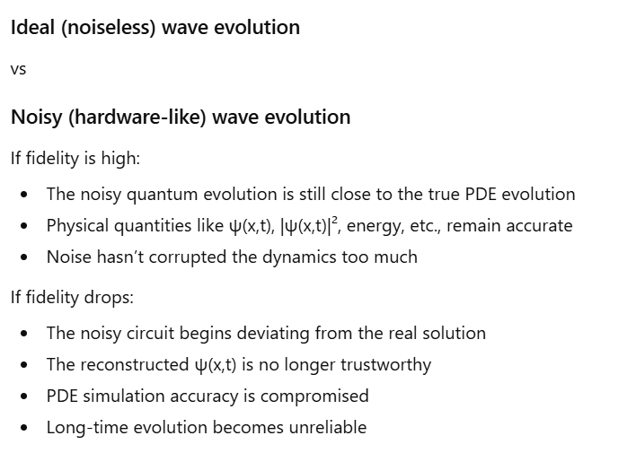
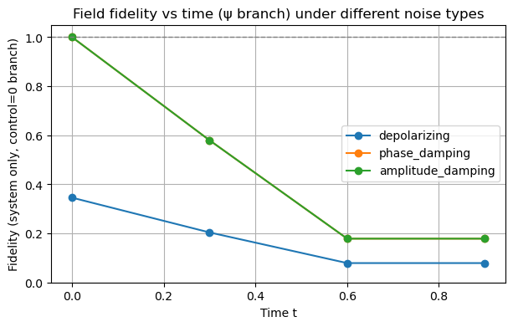
Test4 - Fidelity vs. time under different noise types
Noise Type | What It Affects | Physically Represents | Impact on Your Wave Simulation
Depolarizing | Randomizes the whole state | Gate errors, hardware instability | Strong distortion of ψ
Phase Damping | Removes phase coherence only | T₂ decoherence | Minimal impact
Amplitude Damping | Energy loss (1→0) | T₁ relaxation | Kills wave amplitude over time

Slide 26
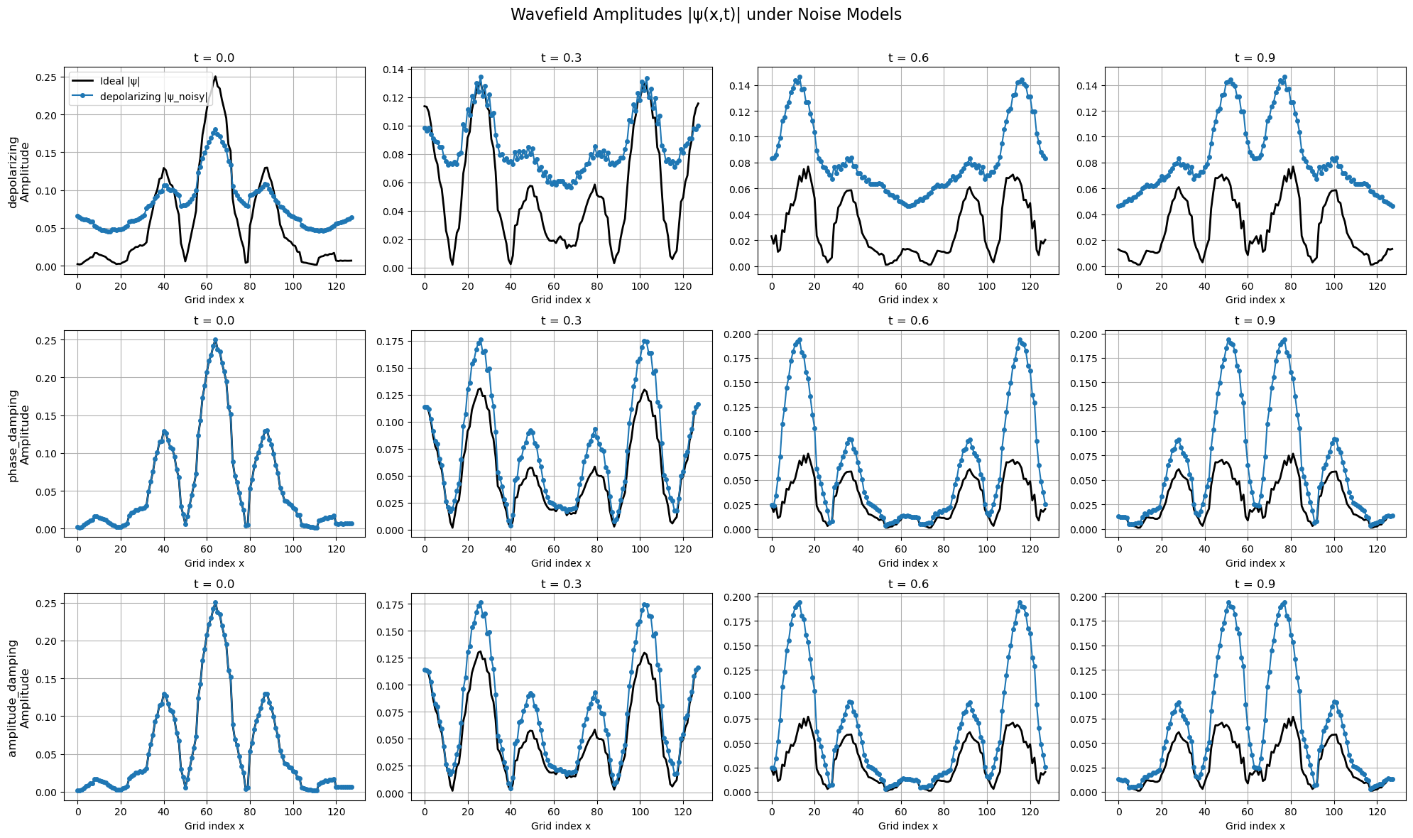

Slide 27
Decoding the Quantum Circuit
  Examine how each quantum gate contributes to the 1D wave evolution and how it approximates the underlying continuous dynamics.
  Resolve current implementation issues so the gate-based simulation reproduces outcomes consistent with the State vector (ideal) benchmark.
Validation and Benchmarking
  Compare Quantum Circuit outputs with the State vector reference to identify discrepancies caused by discretization, numerical rounding, or gate sequencing.
  Compute state fidelity between noiseless and noisy simulations to quantify the impact of circuit noise on physical accuracy.
Incorporating Realistic Noise
  Introduce hardware-based or custom noise models using Qiskit Aer to emulate decoherence, gate, and measurement errors.
  Analyze error propagation and fidelity degradation across varying circuit depths and time steps to better understand NISQ limitations.
Optimization Outlook ( bit ambitious? .. )
  Use insights from fidelity and noise analysis to refine circuit design, reduce gate depth, and enhance numerical stability—bringing the simulation closer to hardware feasibility.
Status ~

Slide 28
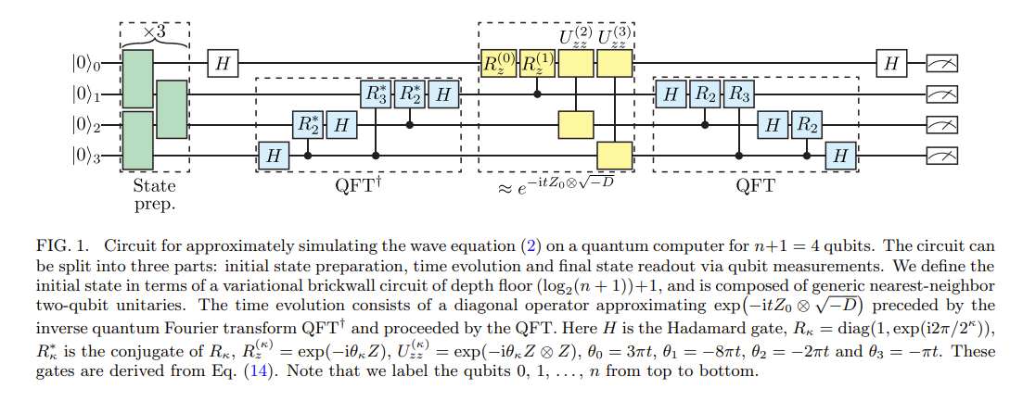
Confusion! ~

Slide 29
